Slide 1

Meet the Experts Revit Architecture 2009 Special briefing for Authors
Starts at: 8:00 am US West Coast; 11:00 am US East Coast;
16:00pm UK; 17:00 pm Central Europe
Jeremy Tammik
Scott Latch
Philip Membreno
Tobias Hathorn

Slide 2
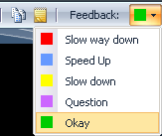
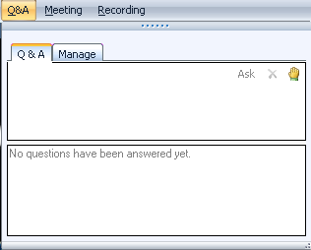
Before we start LiveMeeting – how to
Full Screen Mode
Provide feedback
Realtime Q&A
Expand to full screen mode
Press ESC to return
Notes:
This conference is muted, so you cannot hear anybody else than me talking, and cannot provide feedback through the phone conference. We will unmute it and open it up for general discussion and questions and answers at the end. Meanwhile, written questions can be entered in the live meeting console and will be answered in realtime during the presentation by my colleagues. Thank you very much for that support! Since I will be switching back and forth between these slides and live demonstrations in Revit and Visual Studio, I will set my computer to low resolution and full screen mode to reduce bandwidth and speed up the display. This means I will not see the live meeting console and the feedback panel. My colleagues will be monitoring the livemeeting console and also answering questions online. We will post the materials from this presentation together with the audio recording.

Slide 3
Before we start LiveMeeting – how to
*6 to mute your telephone
*6 to unmute your telephone
Please feel free to interrupt with questions at any time

Slide 4


Speaking today from Autodesk
Jeremy Tammik
Senior Engineer, DevTech EMIA
Scott Latch
Revit Architecture Product Manager
Philip Membreno
Quality Assurance Analyst
Tobias Hathorn
Revit Building QA Analyst

Slide 5
Agenda
Overview of Revit 2009 New Features
Demonstrations
Questions and Answers

Slide 6
Revit 2009 New Features

Slide 7


